Slide 1

Hydrocarbon Exploration using Seismic Imaging
DEPARTMENT OF COMPUTER SCIENCE AND ENGINEERING
Under the guidance of :
Mrs. Madhushree Assistant Professor, Dept. of CSE
Project By:
Abhishek Varma (1SG15CS004), Aman Gupta (1SG15CS008), Dylan Saldanha (1SG15CS026)

Slide 2
CONTENTS
INTRODUCTION
PROBLEM STATEMENT
SYSTEM ARCHITECTURE
REQUIREMENTS
SOFTWARE REQUIREMENTS
HARDWARE REQUIREMENTS
SYSTEM DESIGN
DATA FLOW DAIGRAM
SEQUENCE DIAGRAM
PROPOSED ALGORITHM
REFERENCES

Slide 3
INTRODUCTION
Seismic data is collected using reflection seismology, or seismic reflection
Reflection seismology is similar to X-ray, sonar and echolocation
Salt density is usually 2.14 g/cc which is lower than most surrounding rocks
The seismic velocity of salt is 4.5 km/sec, which is usually faster than its surrounding rocks
This difference creates a sharp reflection at the salt-sediment interface

Slide 4
PROBLEM STATEMENT
To find potential reserves of hydrocarbons in the vicinity of the area under inspection.

Slide 5
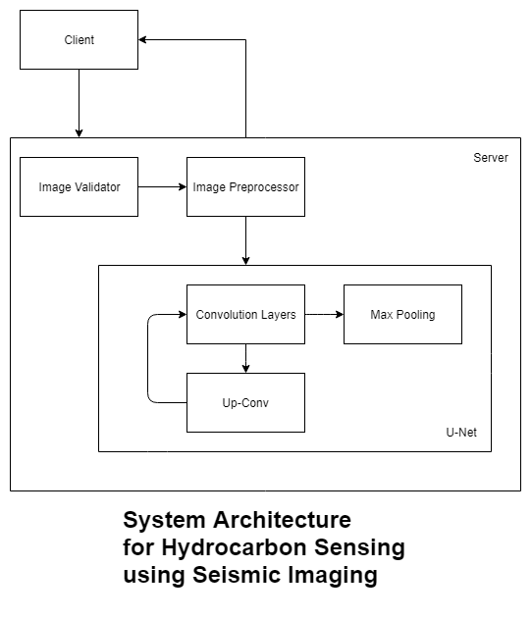
System Architecture

Slide 6
Requirements
Software Requirements
Python 3.x
Chrome/Firefox with HTML 5 Support
Flask and related libraries
Windows Vista or above
Hardware Requirements
1 GB HDD
Intel Pentium Dual Core 2GHz or above
4GB RAM or above

Slide 7
Functional and Non Functional Requirements
Functional Requirements
System should be able to identify pixels with salt and those without.
Should have an acceptable accuracy.
Should be able to classify images of any size.
System should be able to respond within 3 seconds.
Non Functional Requirements
Portability
Ease of Use
Ease of Setup
Low Maintenance Costs
Scalable

Slide 8
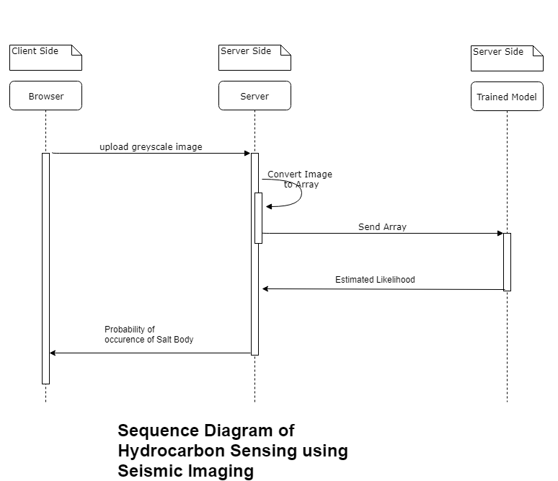
System Design

Slide 9
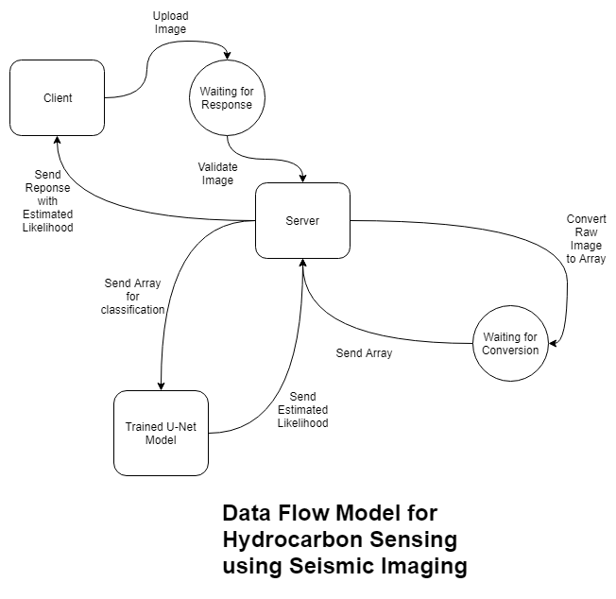

Slide 10
Implementation
The algorithm proposed is to use the Structure of a U-Net.
U-Net is considered one of standard architectures for image classification tasks, when we need not only to segment the whole image by its class, but also to segment areas of image by class
U-Net predicts a pixel wise segmentation map of the input image rather than classifying the input image as a whole. For each pixel in the original image, it asks the question: “To which class does this pixel belong?’’

Slide 11
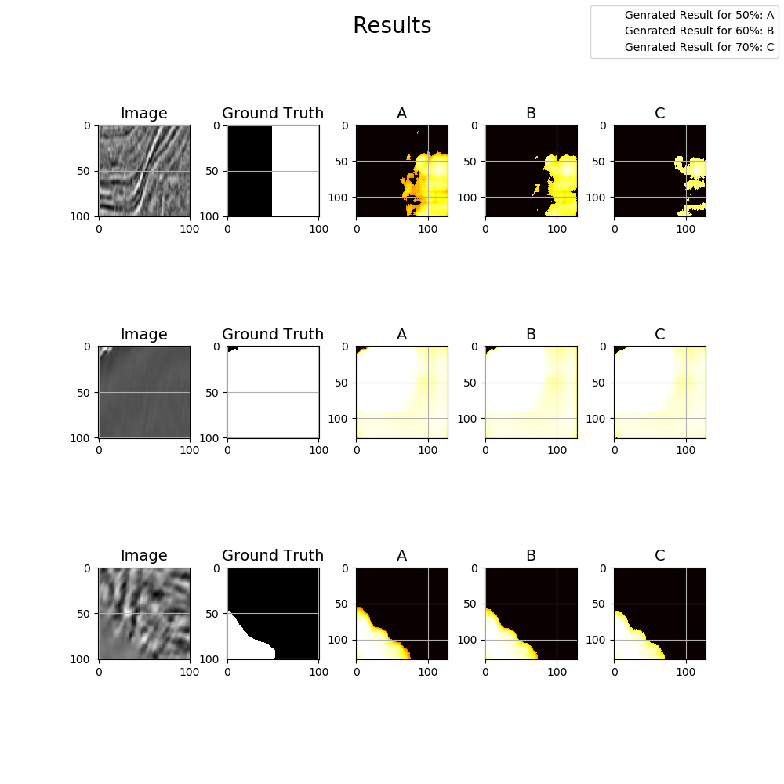

Slide 12
Testing
Sl.No. | Test Case | Cases Passed
1 | System should be able to identify pixels with salt and those without. | Yes
2 | Should have an acceptable accuracy. | Yes
3 | Should be able to classify images of any size. | Yes
4 | System should be able to respond within 3 seconds. | Yes

Slide 13
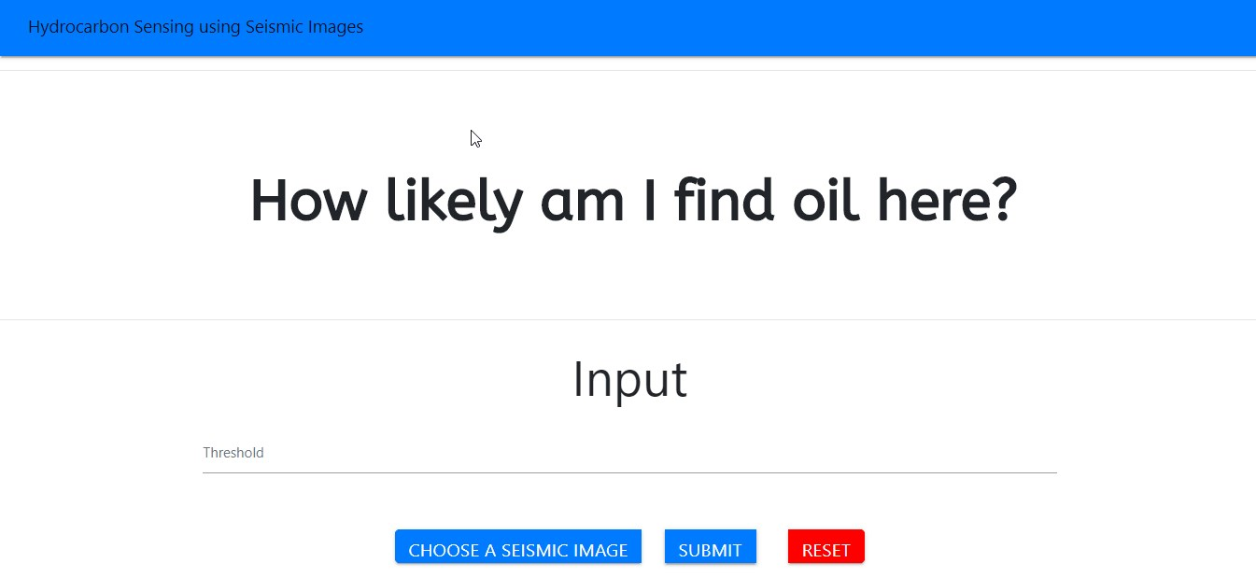
Screenshots

Slide 14
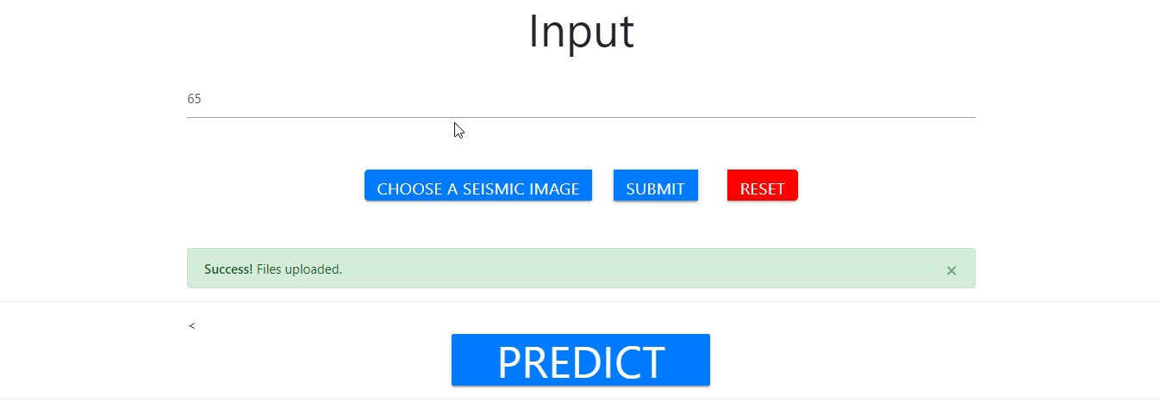

Slide 15
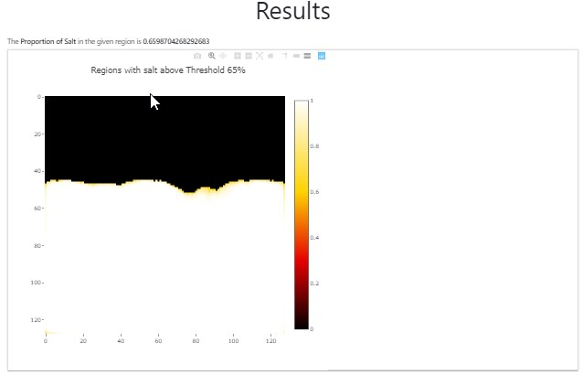

Slide 16
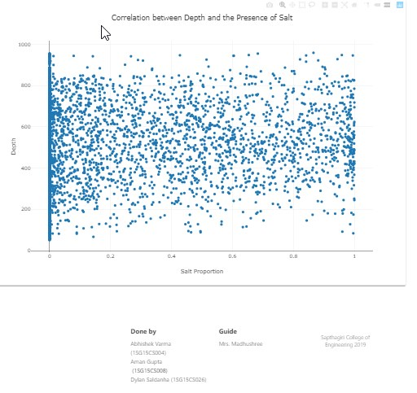

Slide 17
ReferENces
SL.NO. | AUTHOR | TITLE OF THE PROJECT | PROPOSED YEAR
1 | Guillen, Pablo & Larrazabal, German & Gonzalez, Gladys & Boumber, Dainis & Vilalta, Ricardo | Supervised Learning to detect Salt Body | 2017
2 | Shi, Yunzhi & wu, Xinming & Fomel, Sergey. | Automatic salt-body classification using deep-convolutional neural network. | 2018

Slide 18
ReferENces
SL.NO. | AUTHOR | PROPOSED SYSTEM | PROPOSED YEAR
3 | Araya-Polo, Mauricio, Taylor Dahlke, Charlie Frogner, Chiyuan Zhang, Tomaso Poggio, and Detlef Hohl | Automated Fault Detection Without Seismic Processing. | 2017
4 | O'Shea, Keiron & Nash, Ryan. | An Introduction to Convolutional Neural Networks. | 2015

Slide 19
REFERENCES
SL.NO. | AUTHOR | PROPOSED SYSTEM | PROPOSED YEAR
5 | Ronneberger, Olaf & Fischer, Philipp & Brox, Thomas. | U-Net: Convolutional Networks for Biomedical Image Segmentation. | 2015
6 | Zhen Wong, Zhiling Long & Ghassan AlRegib | Tensor-based subspace learning for tracking salt-dome boundaries | 2015
7 | Taylor Dahlke, Mauricio Araya-Polo | Predicting geological features in 3D Seismic Data | 2016

Slide 20
REFERENCES
SL.NO. | AUTHOR | PROPOSED SYSTEM | PROPOSED YEAR
8 | Henry W. Lin, Max Tegmark, and David Rolnick. | Why does deep and cheap learning work so well? | 2017
9 | Seokmin Oh, Kyubo Noh, Daeung Yoon, Soon Jee Seol, Joongmoo Byun. | Salt Delineation from electromagnetic data using CNNs | 2018
10 | Charlie Frogner Chiyuan Zhang, Hossein Mobahi, Mauricio Araya-Polo & Tomaso Poggio | Learning with a Wasserstein Loss | 2015

Slide 21
THANK YOU

